Slide 1
State of the PD

Slide 2
Demographics and Calls for Service
2
According to the United States Census Bureau, the City of Fife was estimated to have a population of 10,184 residents in 2019.
City of Fife Population and Demographics
2019 Violations Issued by Race
Annually, Department Administration reviews available data related to traffic stops, including demographic data, existing procedures, practices and training, as well as complaints of bias-based policing. In 2018, 96% of violations issued were to non-residents of Fife. Data for 2019 is still being compiled at this time.
*Credit: Violations issued as reported by SECTOR

Slide 3
Use of Force Reporting
3
Reportable uses of force include an Officer’s deployment of control tactics and/or control devices, impact devices and deadly use of force. Fife PD categorizes the intentional draw and direct of a weapon (firearm, TASER, 40mm launcher) as a reportable use of force, although it does not involve an actual application of force.
2019 Use of Force by Type
Use of Force Response forms are completed by the Officer(s) who used force, generally within 24 hours, but no greater than 48 hours following the incident. Additionally, any Officer involved in or witnessed the application of force is required to document their actions and observations in the narrative portion of their reports.
These reports and Use of Force Response forms are reviewed by the Officers’ immediate supervisor, forwarded to the Assistant Chief of Operations, and finally to the Assistant Chief of Administrative Services. In each step, the Use of Force Response form is reviewed, the case report is reviewed, and once approved, the form is attached to the case report. The forms are reviewed for accuracy and content to ensure compliancy with Department policy and to identify and address training needs. In cases where a supervisor uses force, Command Staff will review the report prior to forwarding. Command Staff uses of force are reviewed by the Chief of Police. This review process ensures multiple levels of review and the application of force is in in compliance with policy and law, and meets department expectations.
FORCE TYPE | INCIDENTS
CONTROL TACTICS | 88
IMPACT STRIKES | 4
TASER DISPLAYED | 13
TASER DISCHARGED | 2
40mm DISPLAYED | 2
FIREARM DISPLAYED | 175
FIREARM DISCHARGED | 0
OC DISCHARGED | 0
DEADLY FORCE | 0
GRAND TOTAL | 284
In situations where a subject complains of pain or believes the force used was excessive, a supervisor will respond to begin an investigation. Investigative resources may include interviewing the subject, reviewing radio transmissions, reviewing available video footage, and contacting the Command Duty Officer.
Statistics were gathered from each categorical Use of Force listed. Moreover, the incidents were reviewed identifying specific patterns of activity by personnel, primarily identifying the trends in types of force, frequency of use, type of tool used, and associated injury to personnel and subjects.

Slide 4
Use of Force
4
2019 Use of Force by Type
Fife PD responded to 19,611 calls for service in 2019. That year, the Department reported 284 incidents in which a Use of Force Response Form was completed. This applied to 154 persons contacted, many of which had multiple officers involved with the contact.

Slide 5
Use of Force
5
2019 Composition of Use of Force
A note that some of the reported incidents resulted in more than one type of force used (i.e. firearm displayed went to physical controls, or 40mm displayed accompanied by firearm displayed).

Slide 6
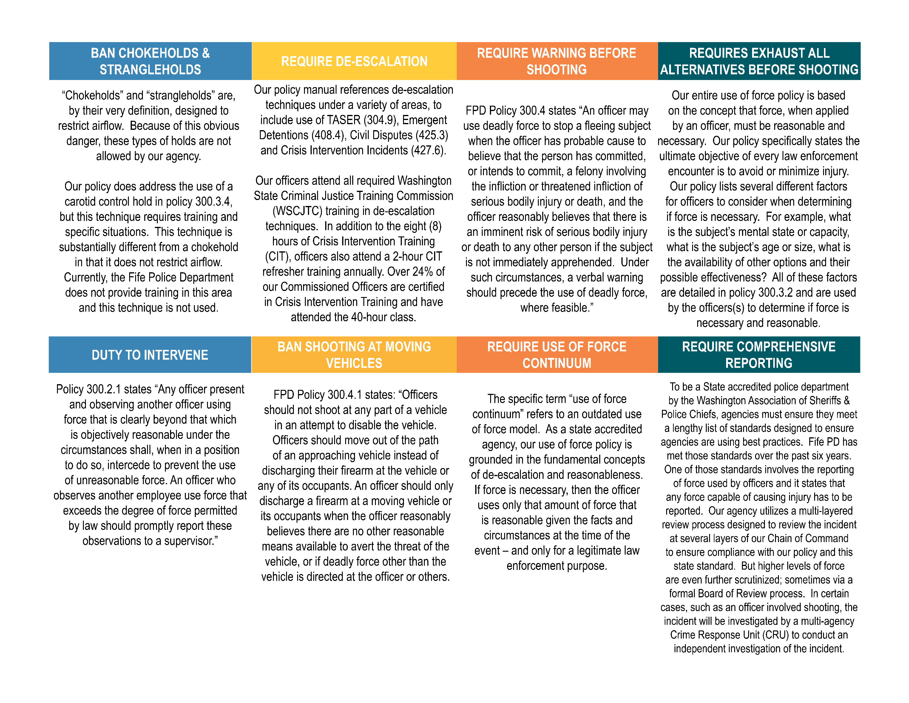
8 Can’t Wait
6

Slide 7
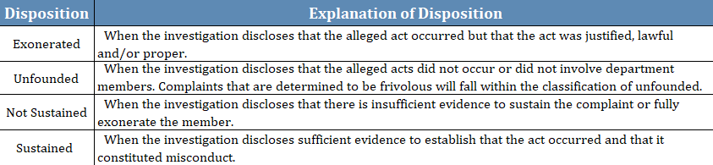
Complaints and IAs
7
The Fife Police Department takes seriously any allegations of unprofessional behavior or misconduct on the part of our employees and investigates every complaint received.
In 2019, Fife PD recorded 19 complaints*, of which eight were exonerated, seven were unfounded, four were sustained, and one was not sustained. Fife PD conducted four Internal Affairs Investigations in 2019 resulting in a total of three sustained findings and one unfounded.
*One of the 19 complaints involved two officers for the same event with different allegations, resulting in 20 complaint investigations
Complaints Per Calls For Service | 2019
Calls for Service (CFS) | 19,611
Individual Complaints | 19
Sustained Complaints | 4
Complaints per CFS | .001
Sustained Complaints per CFS | .0002

Slide 8
Accreditation
8
Originally awarded in May of 2016, Fife PD successfully completed re-accreditation in April of 2020. Out of 253 Law Enforcement Agencies* in Washington State, 49 are currently accredited.
What is Accreditation?
Overseen by the Washington State Association of Sheriffs and Police Chiefs Professional Services Committee, Accreditation Commission, and Board of Directors, the accreditation program provides a review process for agencies to be certified as operating under industry best practices and standards.
What are the benefits of Accreditation?
To increase public confidence in the agency
To increase credibility
To provide systemized agency self-assessment
To broaden perspectives
To intensify administrative and operational effectiveness
To ensure recruitment, selection, and promotion processes are fair and equitable
To strengthen understanding of agency policies and procedures by agency personnel
To improve agency morale and pride
To decrease susceptibility to litigation and costly civil court settlements;
To potentially reduce liability insurance costs
To provide state and local recognition of professional competence.
*Courtesy www.waspc.org/accreditation; Law Enforcement Agencies listed does not include Tribal Agencies

Slide 9
Accreditation
9
Accreditation is comprised of 137 standards that are “have-to practices” as determined by law or a universal practice within the profession and are mandatory for every agency, including standards covering Use of Force, Training, Biased-Based Prohibition and Internal Affairs.
The agency has a policy prohibiting biased‐based profiling, which also has been known as “racial profiling” (Standard 13.3)
The agency has policies directing personnel to only utilize the amount of force which is necessary to affect lawful objectives to include any amount of force up to and including deadly force. (Standard 3.1)
The agency has a policy governing the use of warning shots. (Standard 3.2)
The agency has a policy governing the use of non‐lethal weapons. (Standard 3.3)
The agency has a policy requiring appropriate medical aid after the use of force, when an injury is known, suspected, or is alleged. (Standard 3.4)
The agency has a policy requiring personnel to submit a use of force report to the agency Chief Executive Officer or designee when they: Discharge a firearm (other an routine training or recreational purposes); Take any action that is capable of injuring a person. (Standard 3.5)
The agency has an officer involved shooting/deadly force response policy that includes steps for first responders and includes a comprehensive independent investigation and review of the event. (Standard 3.6)
The agency has a policy that requires an annual management review and analysis, with final review approved by the chief executive officer, of the following incidents: Vehicle pursuits; Use of force events; Internal Investigations; Biased based profiling incidents (Standard 4.3)
The agency can show 100% compliance with the annual WSCJTC requirement for training. (Standard 11.5)
At least annually, agency personnel receive in‐service training on the agency’s use of force and deadly force policies. (Standard 11.8)
In‐service training for non‐lethal weapons shall occur at least once every two years. (Standard 11.9)
The agency requires the documentation and investigation of all complaints of misconduct or illegal behavior against the agency or its members. (Standard 14.1)
The agency maintains records of complaints and their dispositions in accordance with Washington State Retention Guidelines. (Standard 14.5)
*Courtesy www.waspc.org/accreditation

Slide 10
PERF’s 30 GUIDING PRINCIPLES
10
Police Executive Research Forum (PERF)
Founded in 1976 as a nonprofit organization, the Police Executive Research Forum (PERF) is a police research and policy organization and a provider of management services, technical assistance, and executive-level education to support law enforcement agencies. PERF helps to improve the delivery of police services through the exercise of strong national leadership; public debate of police and criminal justice issues; and research and policy development.
How PERF’s Use-of-Force Guiding Principles Were Developed
Approximately 200 police chiefs and other police officials from various ranks, along with federal officials, academics, and mental health experts, came to Washington, DC on January 29, 2016, for a meeting convened by PERF to continue discussions about new strategies for reducing police use of force in certain types of situations that do not involve suspects with firearms.

Slide 11
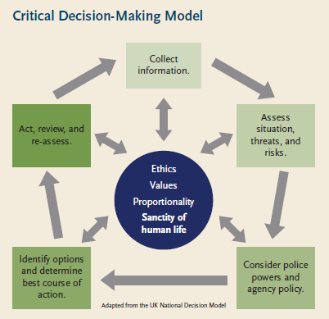
PERF’s Critical Decision-Making Model
11
The Critical Decision-Making Model is a five-step critical thinking process. All five steps are built around the core values of the department and the policing profession.
Step 1: Collect Information
Step 2: Assess Situation, Threat and Risks
Step 3: Consider Police Powers and Agency Policy
Step 4: Identify Options and Determine the Best Course of Action
Step 5: Act, Review and Reassess

Slide 12
PERF’s 30 GUIDING PRINCIPLES
12
 | Guiding Principles | STATUS | % COMPLETE | NOTES
 | Policy
1 | The sanctity of human life should be at the heart of everything an agency does. | In Progress | 75% | Conversation w/ Guild re: actual language
2 | Agencies should continue to develop best policies, practices, and training on use-of-force issues that go beyond the minimum requirement of Graham v. Connor. | Complete | 100% | Complete and ongoing, function of Lexipol and Legal Updates
3 | Police use of force must meet the test of proportionality. | Complete | 100%
4 | Adopt de-escalation as formal agency policy. | In Progress | 50%
5 | The Critical Decision-Making Model provides a new way to approach critical incidents. | In Progress | 75% | Function of training; Not memorialized - have not officially adopted PERF's model
6 | Duty to intervene: Officers need to prevent other officers from using excessive force. | Complete | 100%
7 | Respect the sanctity of life by promptly rendering first aid. | Complete | 100%
8 | Shooting at vehicles must be prohibited. | Complete | 100% | Shooting at moving vehicles generally prohibited
9 | Prohibit use of deadly force against individuals who pose a danger only to themselves. | In Progress | 75% | NTOA Governmental interest training
10 | Document use-of-force incidents, and review data and enforcement practices to ensure that they are fair and non-discriminatory. | Complete | 100%
11 | To build understanding and trust, agencies should issue regular reports to the public on use of force. | Complete | 100%
12 | All critical police incidents resulting in death or serious bodily injury should be reviewed by specially trained personnel. | Complete | 100% | Addressed in policy, separate Use of Force Review Board
13 | Agencies need to be transparent in providing information following use of force incidents. | Complete | 100%
 | Training and Tactics
14 | Training academy content and culture must reflect agency values. | Deferred | 0% | No authority to make such changes
15 | Officers should be trained to use a Critical Decision-Making Model. | Not Started | 0% | Discussions w/ key personnel, but a matter of practice

Slide 13
PERF’s 30 GUIDING PRINCIPLES
13
 | Guiding Principles | STATUS | % COMPLETE | NOTES
 | Policy
16 | Use Distance, Cover, and Time to replace outdated concepts such as the "21-foot rule" and "drawing a line in the sand." | Complete | 100% | Ongoing training
17 | De-escalation should be a core theme of an agency's training program. | In Progress | 50% | Ongoing and captured in several areas of policy manual
18 | De-escalation starts with effective communications. | Complete | 100% | Function of CIT and de-escalation training
19 | Mental Illness: Implement a comprehensive agency training program on dealing with people with mental health issues. | Complete | 100%
20 | Tactical Training and mental health training need to be interwoven to improve response to critical incidents. | Complete | 100% | CIT training, scenario-based training
21 | Community-based outreach teams can be a valuable component to agencies' mental health response. | In Progress | 75% | County Co-responder program, work with Mission Response Team and relationship with Recovery Innovations
22 | Provide a prompt supervisory response to critical incidents to reduce the likelihood of unncessary force. | Complete | 100% | Policy/24-hour supervision change/CDO notification
23 | Training as teams can improve performance in the field. | In Progress | 75% | Scenario-based training
24 | Scenario-based training should be prevalent, challenging, and realistic. | Complete | 100%
 | Equipment
25 | Officers need access to and training in less-lethal options. | Complete | 100%
26 | Agencies should consider new options for chemical spray. | Deferred | 0%
27 | An ECW deployment that is not effective does not mean that officers should automatically move to their firearms. | Complete | 100% | Function of training
28 | Personal protection shields enhance officer safety and may support de-escalation efforts during critical incidents, including situations involving persons with knives, baseball bats, or other improvised weapons that are not firearms. | In Progress | 25% | Dependent on funding/funding constraints
 | Information Exchange
29 | Well trainined call-takers and dispatchers are essential to the police response to critical incidents. | Not Started | 0% | No control - function of SS911
30 | Educate the families of persons with mental illness on communicating with the call-takers | Deferred | 0% | Communication w/ key stakeholders

